Slide 1
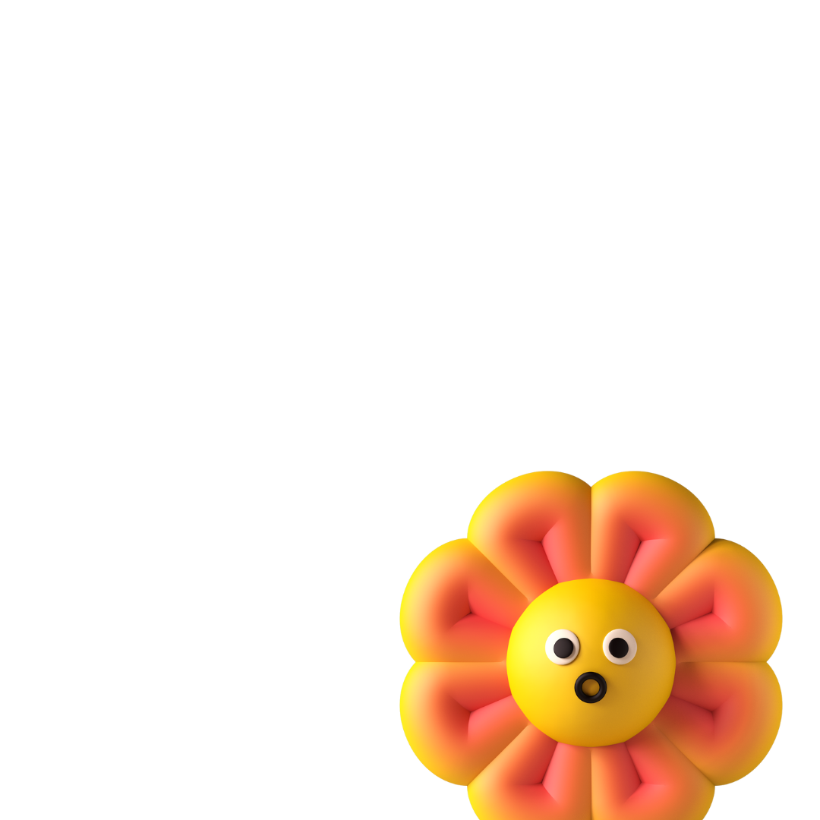
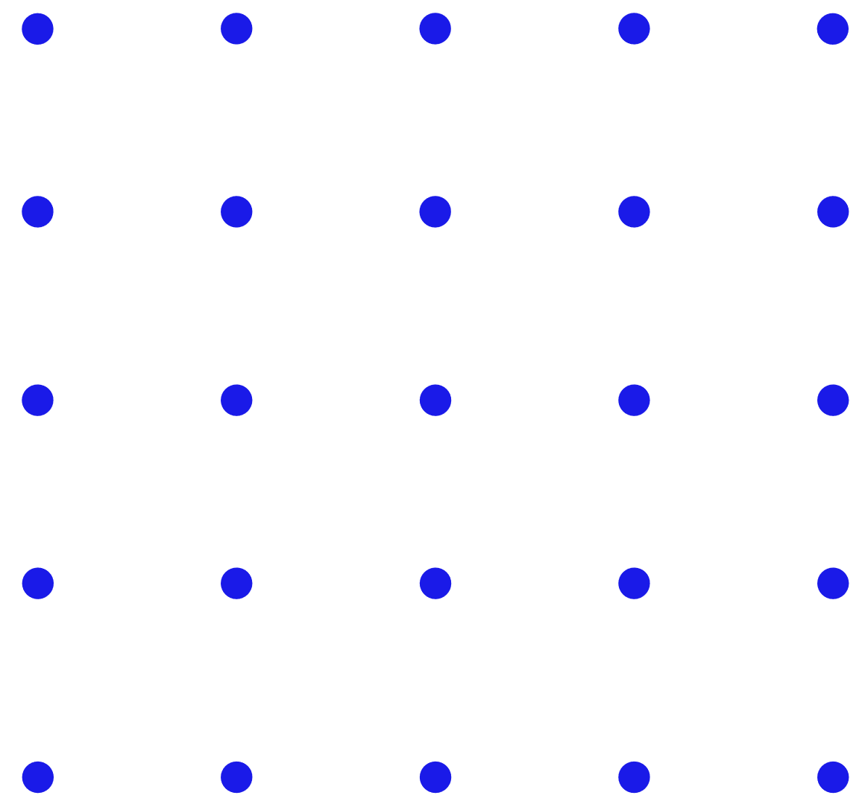
Box Model
By: Dalia Ihab

Slide 2


Box Model
In CSS, the term "box model" is used when talking about design and layout.
The CSS box model is essentially a box that wraps around every HTML element. It consists of: margins, borders, padding, and the actual content. The image below illustrates the box model:

Slide 3
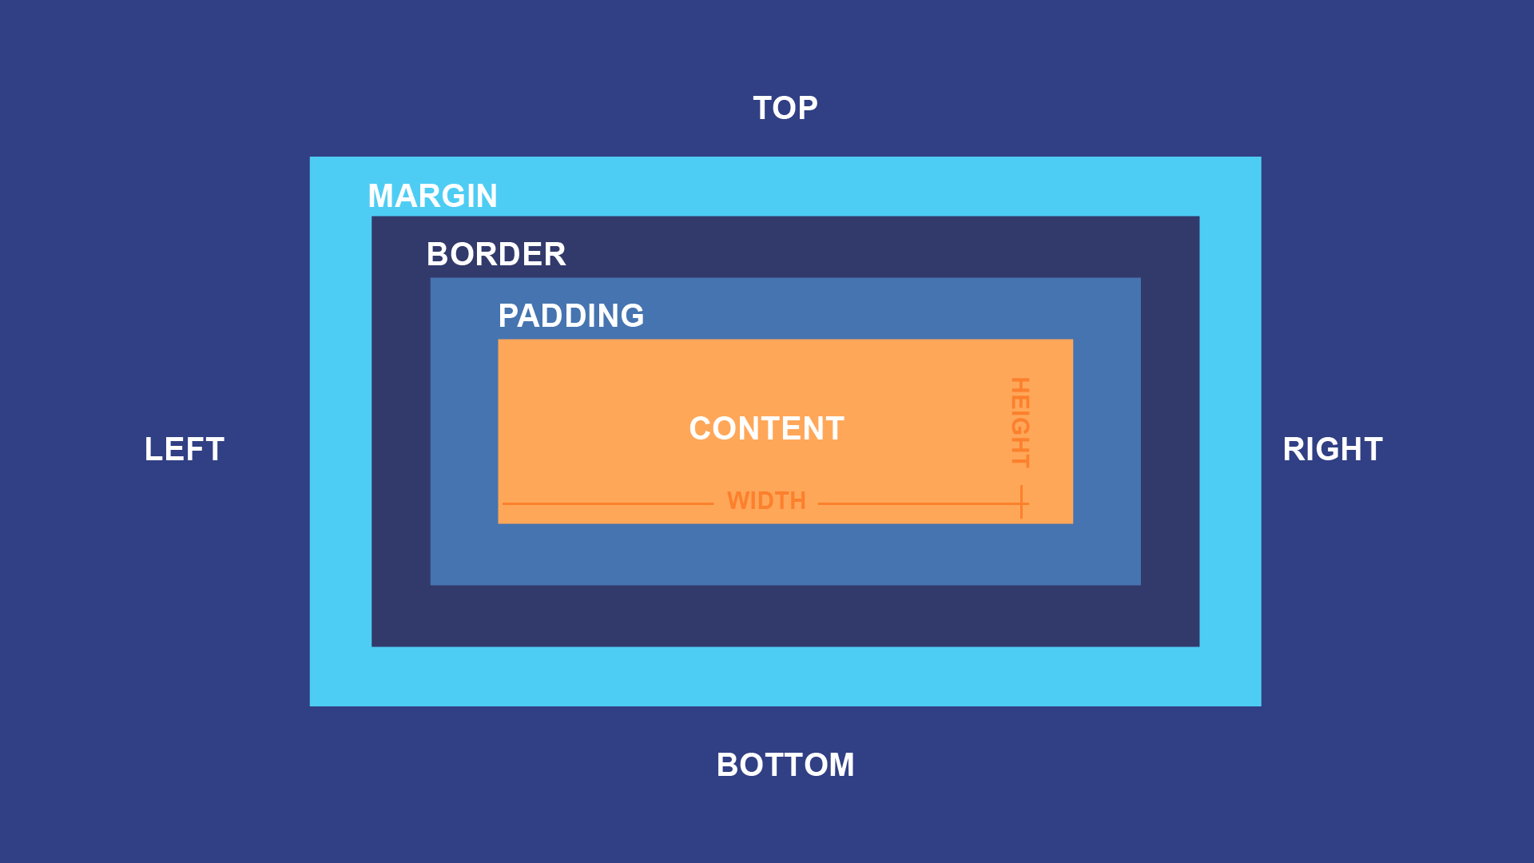
Box Model

Slide 4
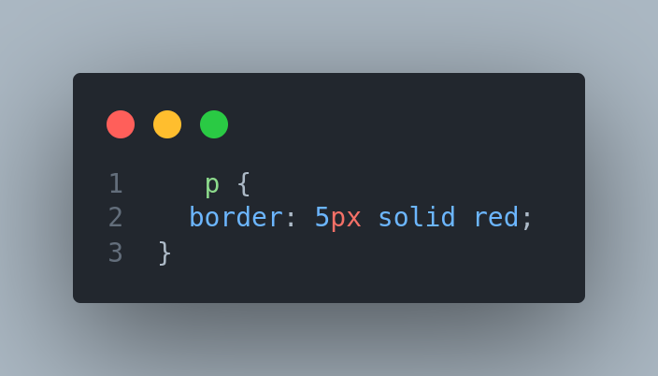
Borders
there are many properties to consider when dealing with borders. To shorten the code, it is also possible to specify all the individual border properties in one property.
The border property is a shorthand :
border-width
border-style (required)
border-color

Slide 5
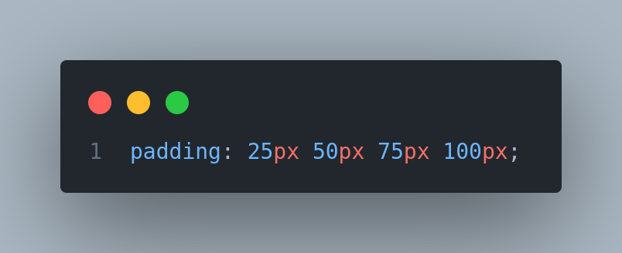
Paddings
The CSS padding properties are used to generate space around an element's content, inside of any defined borders.
With CSS, you have full control over the padding. There are properties for setting the padding for each side of an element (top, right, bottom, and left).

Slide 6
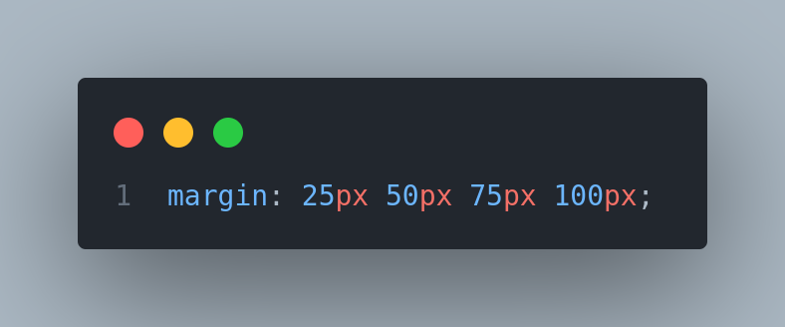
Margins
The CSS margin properties are used to create space around elements, outside of any defined borders.
With CSS, you have full control over the margins. There are properties for setting the margin for each side of an element (top, right, bottom, and left).

Slide 7
Height and Weight

Slide 8


Next
CSS Units

